Slide 1
BUS MANAGEMENT SYSTEM
CAPSTONE PROJECT
Presented by:
S. Nidhish Kumar - Alagappa College of Technology - Industrial Biotechnology - 2021305014

Slide 2
OUTLINE :
Problem Statement
Proposed System/Solution
System Development Approach
Algorithm & Deployment
Result
Conclusion
Future Scope

Slide 3
PROBLEM STATEMENT
To highlight the importance and relevance of Database Management Systems in the bus ticketing and management process.
To enhance customer – service provider relations by making it easier for customer to book tickets with the help of DBMS.
To enable online ticket purchase and prevent queueing in order to buy tickets.

Slide 4
PROPOSED SOLUTION
Usage of Database Management Systems to make purchasing tickets online easier and more convenient than standing in queues.
A well-constructed interface to make the above process efficient and easy for the customer.

Slide 5
SYSTEM APPROACH
1. Registration module -
In the registration module if the customer already has an account then they log in into their account or else if it is a new customer then they are asked to create a new account and to enter their details. The customer can also just log in into their account and check their Bus status and they would not be required to enter any code. The details entered by the customer is later used to automatically fill in the traveller details section if the same person is travelling this makes the process faster and more efficient with less errors

Slide 6
SYSTEM APPROACH
2. Administrative module -
The administrative module is present to manage the back hand of this system. It allows the administrators to manage the site and update the content (like the status of a Bus) at regular intervals. The major operations included in this module are -
Create and maintain Bus schedule, fare and timings of the Bus.
View the passenger list.
Updating the Bus schedule and timings and fare

Slide 7
SYSTEM APPROACH
3. Passenger module -
This module is meant for the customer, where by logging into their account they will be able to view this panel. The major functions included in this module are -
Booking of tickets.
Select their seat number and add meal option.

Slide 8
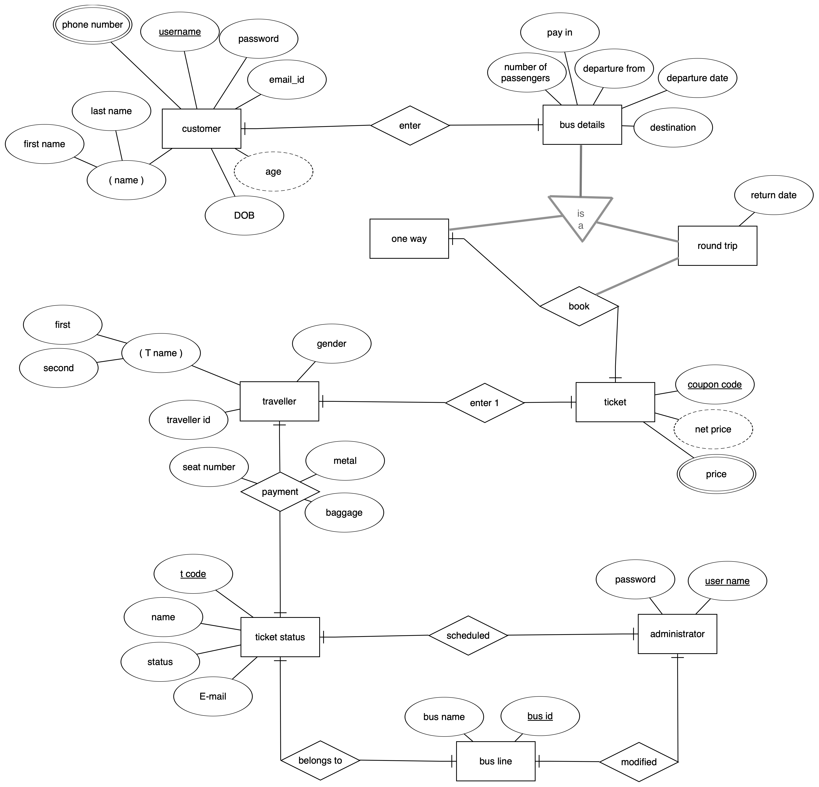
ALGORITHM AND DEPLOYMENT
ENTITY RELATIONSHIP DIAGRAM

Slide 9
ALGORITHM AND DEPLOYMENT
LANGUAGES AND TOOLS USED :
Python
SQLite
DATABASE USED :
SQLite3

Slide 10
RESULT & CONCLUSION
The main purpose of this system is to enable user to reserve or buy ticket online through the internet, and to ensure that customer can purchase ticket without queuing at the counter.
It also implements the concurrent control method in order to ensure no data redundancy.

Slide 11
FUTURE SCOPE
Due to the implementation of concurrent control method, large servers and a secure room are required, which makes this method very expensive and difficult to sustain.

Slide 12
THANK YOU!

